Slide 1
Revolutionizing Parking with IoT Technology
by
Hano M.J
HM

Slide 2
Project Objectives
1
Enhance Parking Efficiency
Our objective is to develop a smart parking system that provides real-time parking availability data to drivers, reducing the time wasted in searching for parking spots.
2
Reduce Traffic Congestion
By guiding drivers to available parking spaces, we aim to decrease the number of vehicles circling the streets, which ultimately leads to reduced traffic congestion.
3
Improve User Experience
Our goal is to create a seamless and user-friendly mobile app interface that allows drivers to easily find and reserve parking spaces, improving their overall experience.

Slide 3
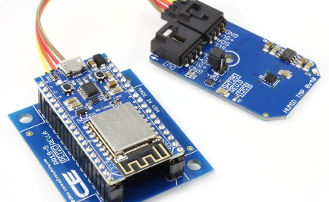
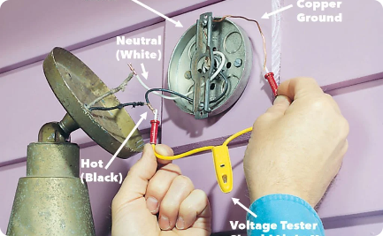
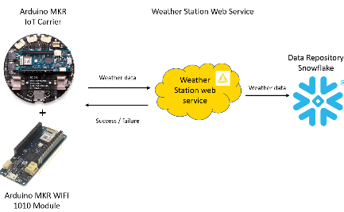
IoT Sensor Setup
Smart Sensors
Ease of Installation
Effortless Data Transmission
We deploy state-of-the-art IoT sensors in parking lots to detect the presence or absence of vehicles, providing accurate real-time parking availability information.
The sensors are easily installed using adhesive or magnetic attachments, ensuring a hassle-free setup process in various parking environments.
The sensors wirelessly transmit the collected parking occupancy data to our central server, enabling instant updates on the mobile app.

Slide 4
Mobile App Development
Real-time Updates
Our mobile app displays real-time parking availability information, allowing drivers to quickly identify and navigate to the nearest available parking spots.
Reservation System
Users can reserve parking spaces in advance through the app, ensuring a hassle-free and guaranteed parking experience.
Payment Integration
Drivers can conveniently pay for their parking through the app, supporting various payment methods for a seamless transaction process.

Slide 5
Raspberry Pi Integration
1
Central Control Unit
The Raspberry Pi serves as the central control unit that collects data from the IoT sensors and communicates with the mobile app.
Data Processing
2
The Raspberry Pi processes the received sensor data and applies intelligent algorithms to convert them into meaningful parking availability information.
3
Seamless Integration
With its compact size and versatile connectivity options, the Raspberry Pi seamlessly integrates into the smart parking infrastructure.

Slide 6

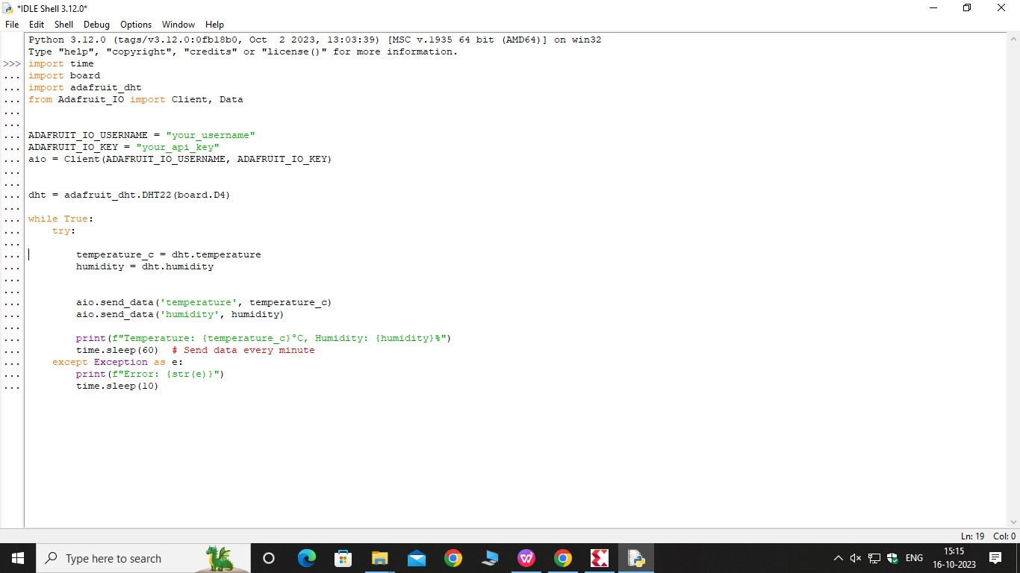
Coding for the Smart Parking app using python

Slide 7
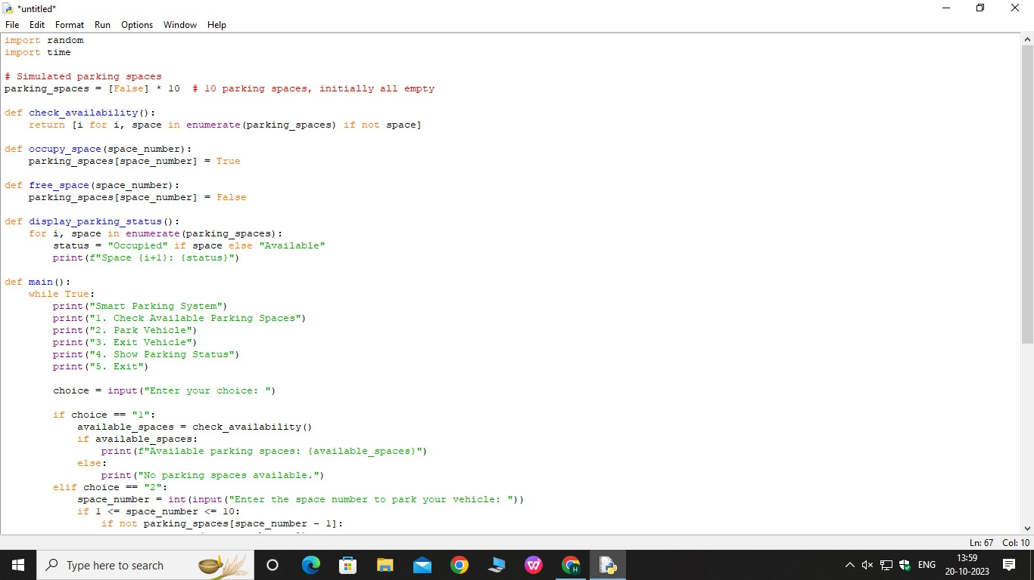

Slide 8
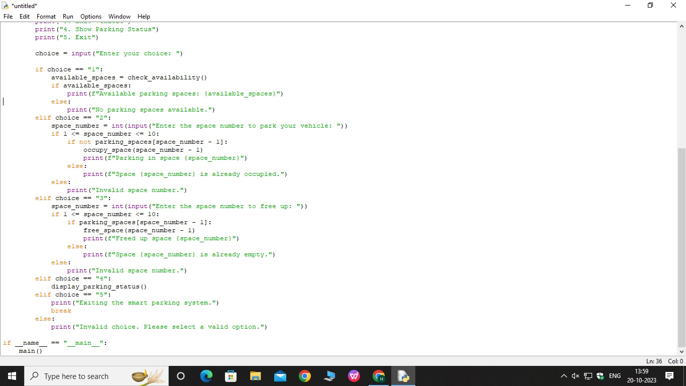

Slide 9
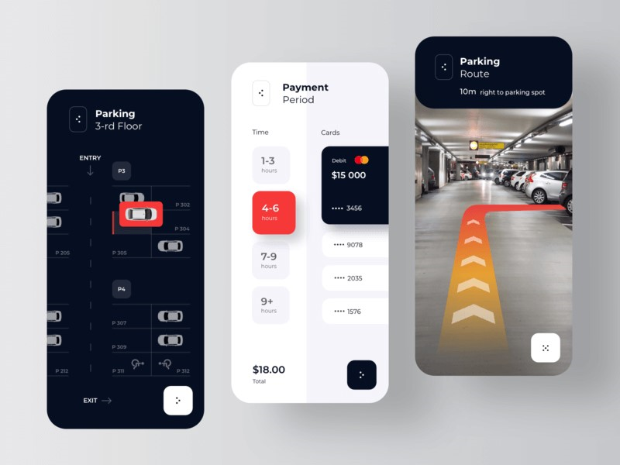
APP INTERFACE

Slide 10
Benefits of Real-time Parking Availability System
Time Savings
Drivers can save significant time by easily locating available parking spaces instead of circling around, reducing stress and frustration.
Reduced Emissions
With fewer cars searching for parking, there will be a decrease in unnecessary idling, resulting in reduced emissions and environmental impact.
Enhanced Parking Revenue
Parking operators can optimize their revenue by utilizing real-time data to maximize the utilization of parking spaces and efficiently manage prices.

